Slide 1
MAVEN
Please visit the repo:
https://github.com/smrmaheshkumar/Maven_Examples

Slide 2
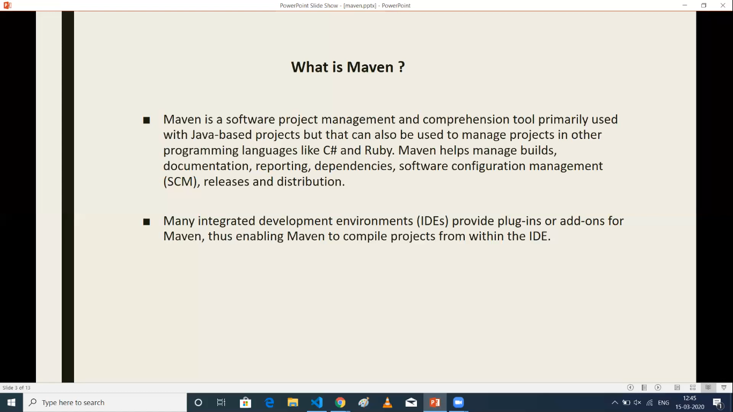

Slide 3
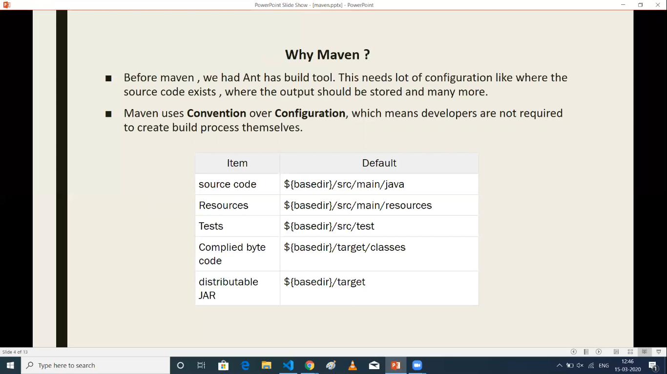

Slide 4
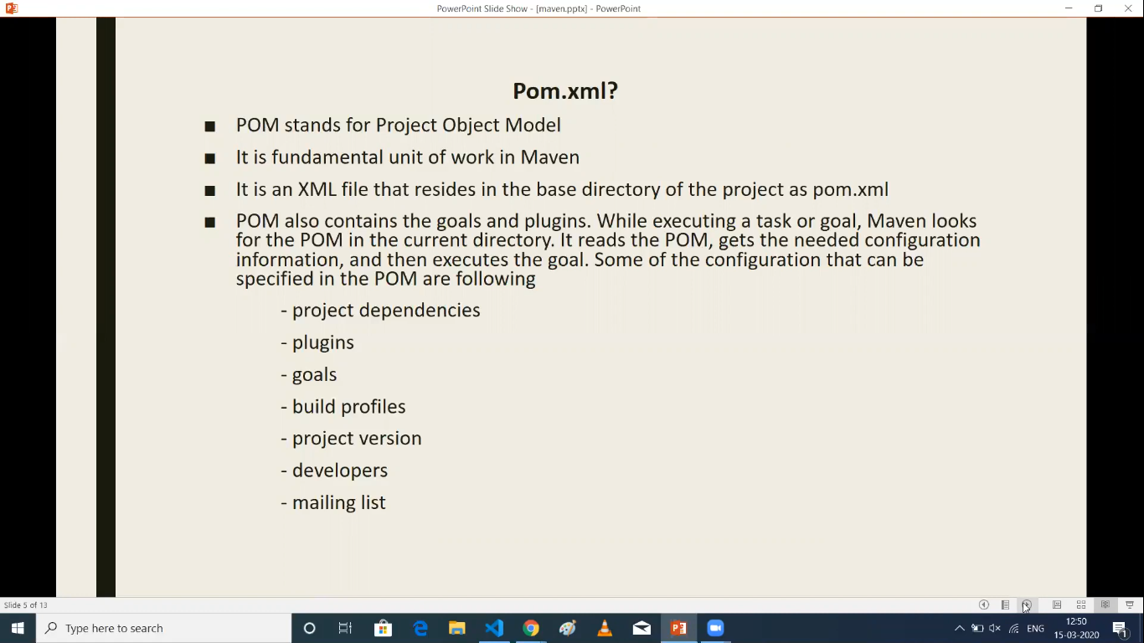

Slide 5
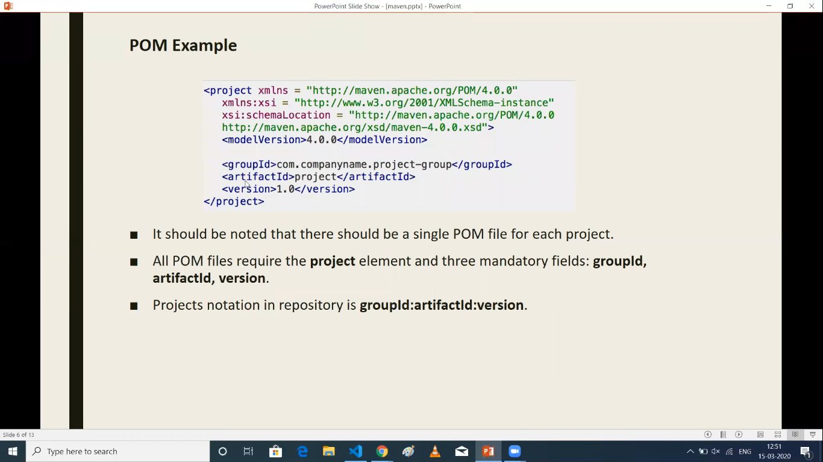

Slide 6
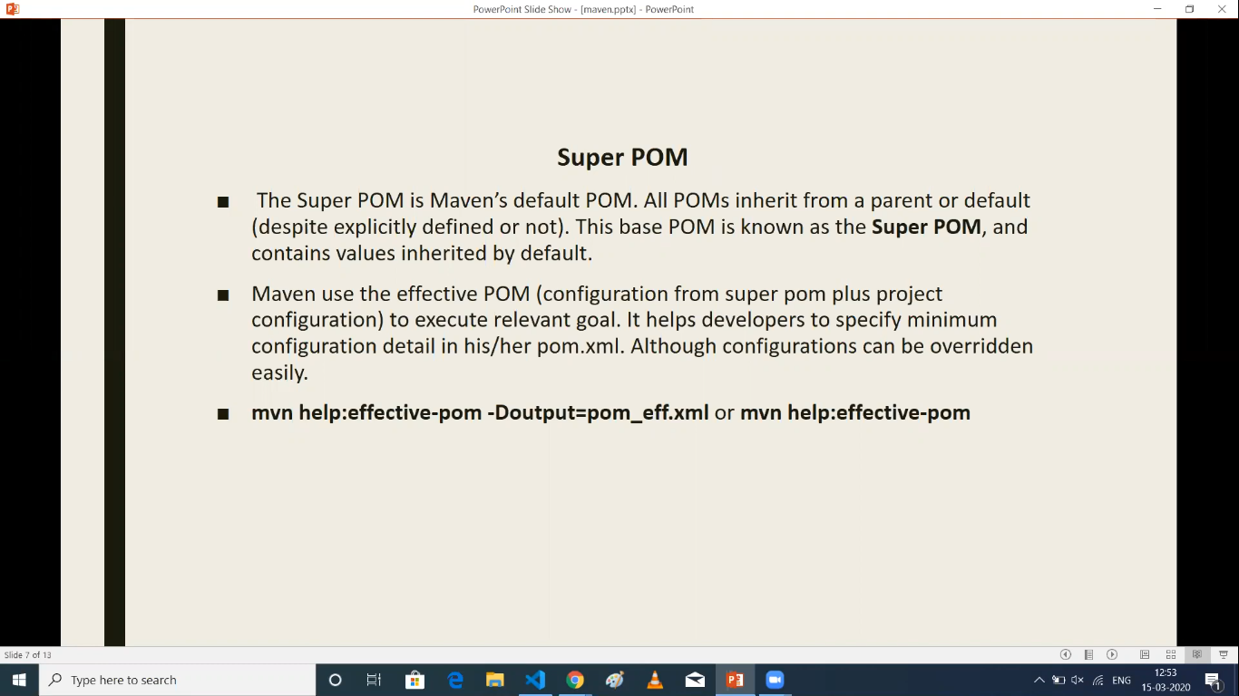

Slide 7
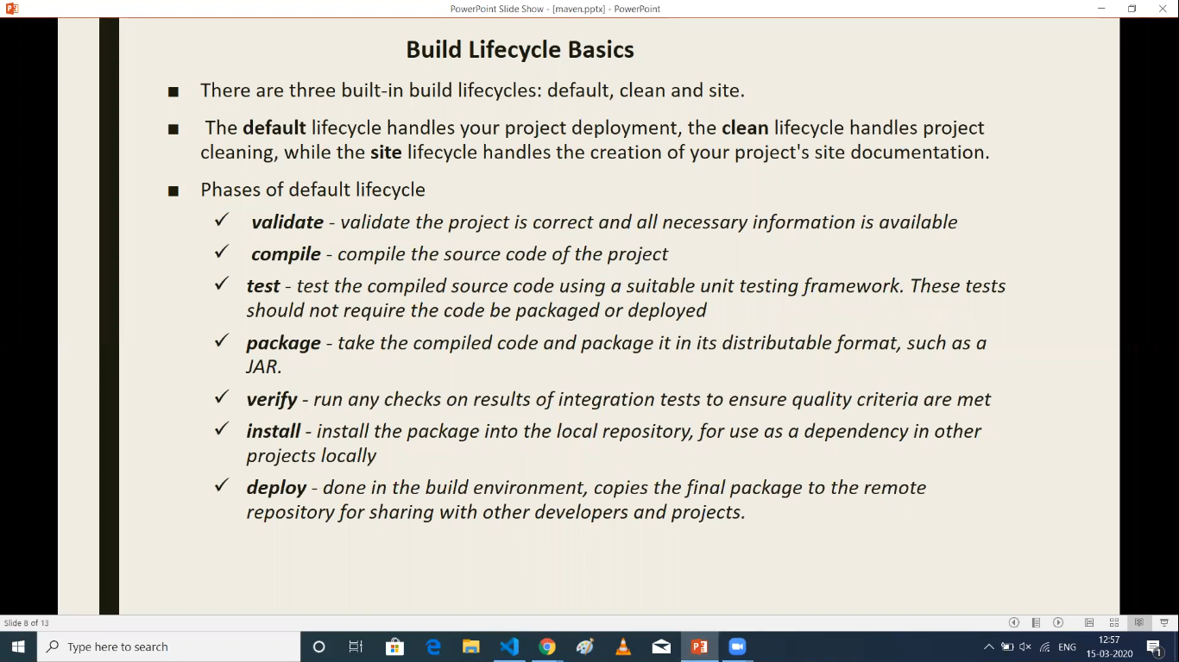

Slide 8
All the dependencies are installed under local /root/.m2/repository
If we modify any change in the dependency in pom.xml the new folder will create
Under the above path
To deploy artifacts to any other Jfrog or Nexus we will use mvn deploy
mvn deploy will use only in master, release or production branches. If not we will use
mvn install
To perform mvn deploy:
Initially we need to get the credentials from ~/.m2/settings.xml. ID should be same in
Settings.xml and in pom.xml
In pom.xml we need to provide <distributionManagement>
The files is shown in the below snapshot
To see dependency mvn dependency:tree It will list all the transitive dependencies

Slide 9
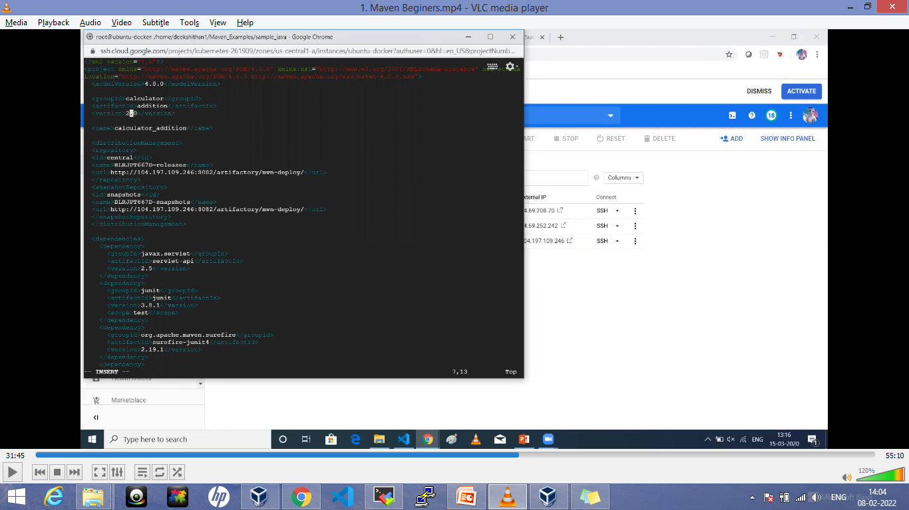

Slide 10
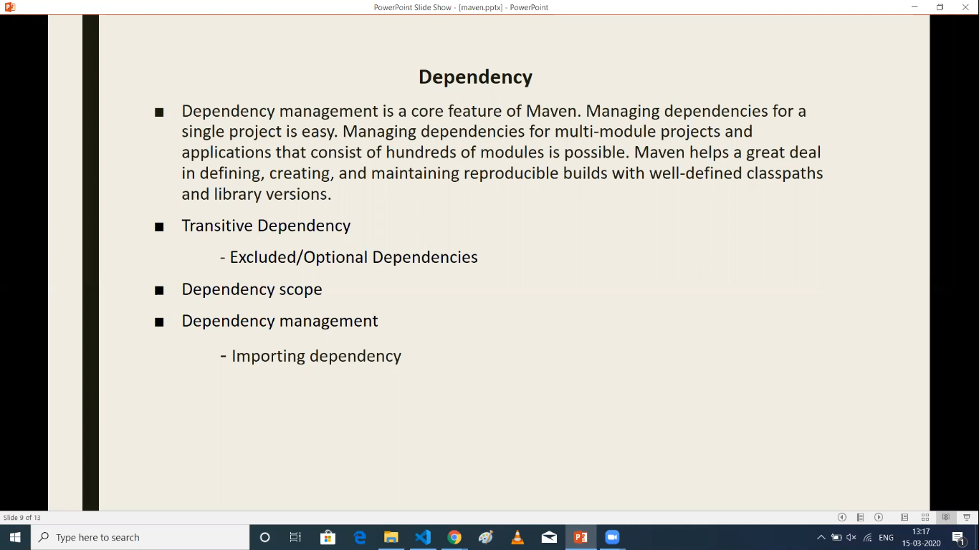

Slide 11
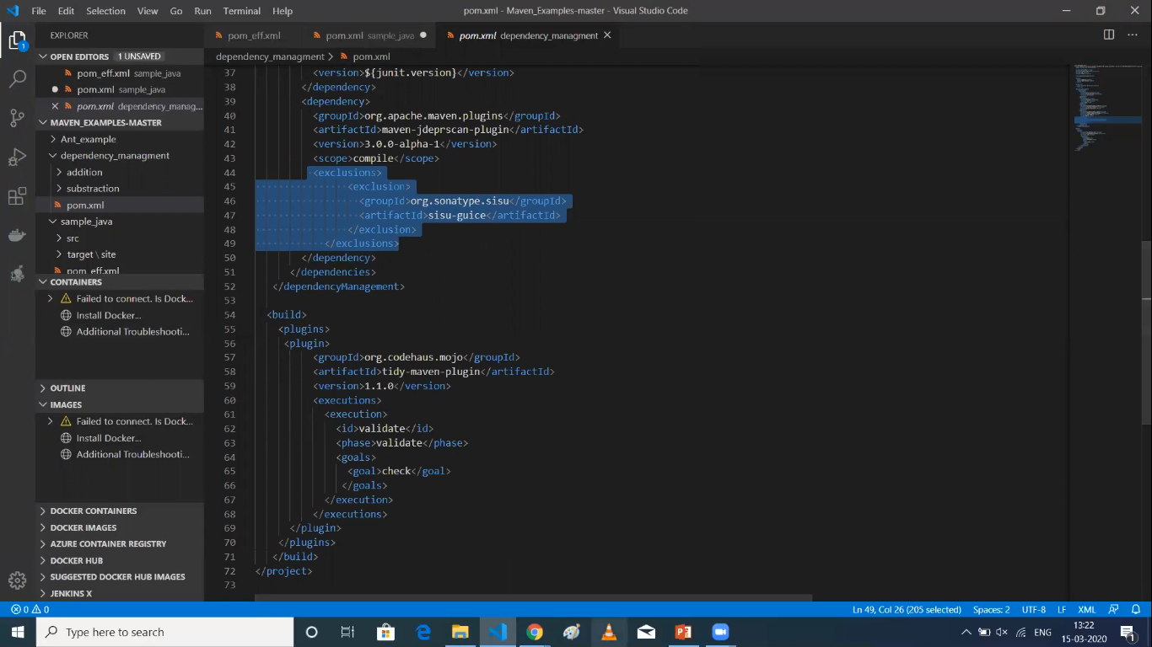
To see dependency mvn dependency:tree It will list all the transitive dependencies.
If we mention exclusion as mentioned in the file. It wont take that dependency

Slide 12
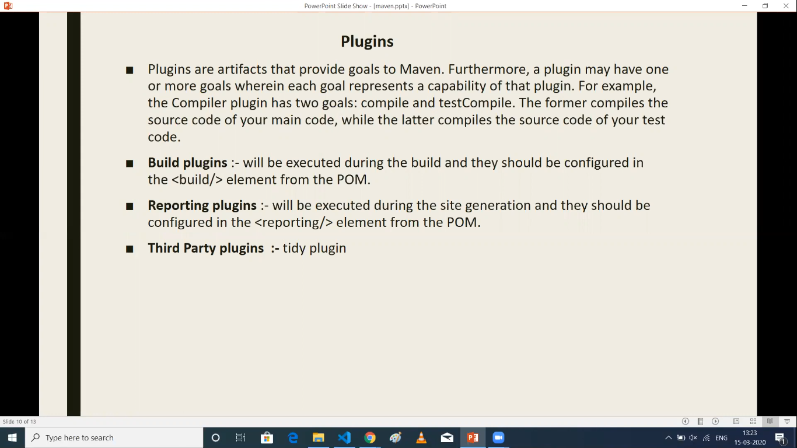

Slide 13
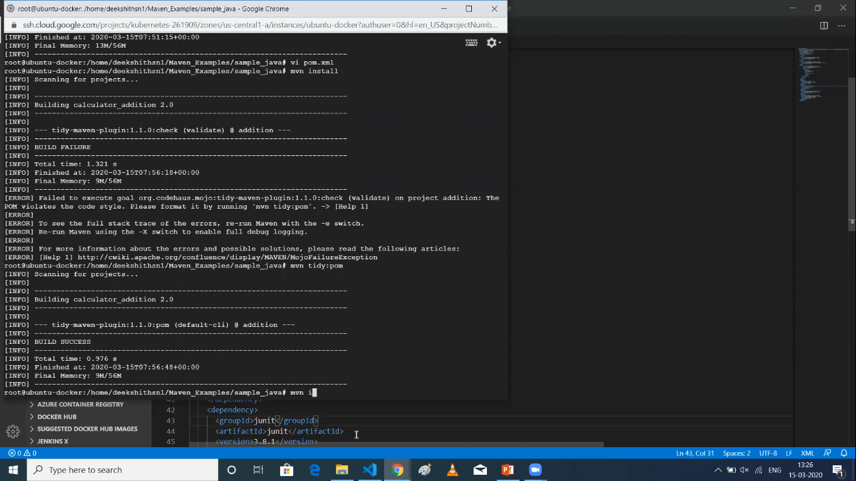
Please see the logs and cpmmands. To get back to the proper order. IN logs it will show to
Execute the particular command

Slide 14
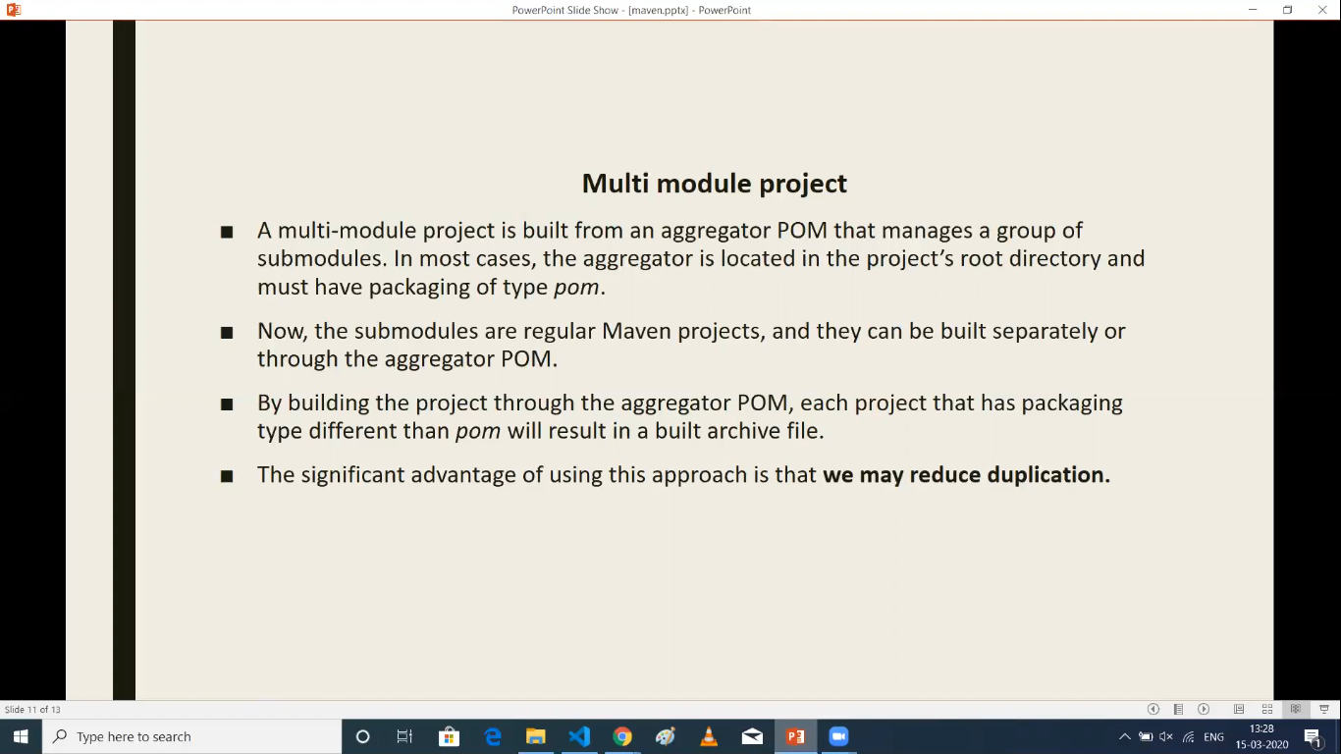

Slide 15
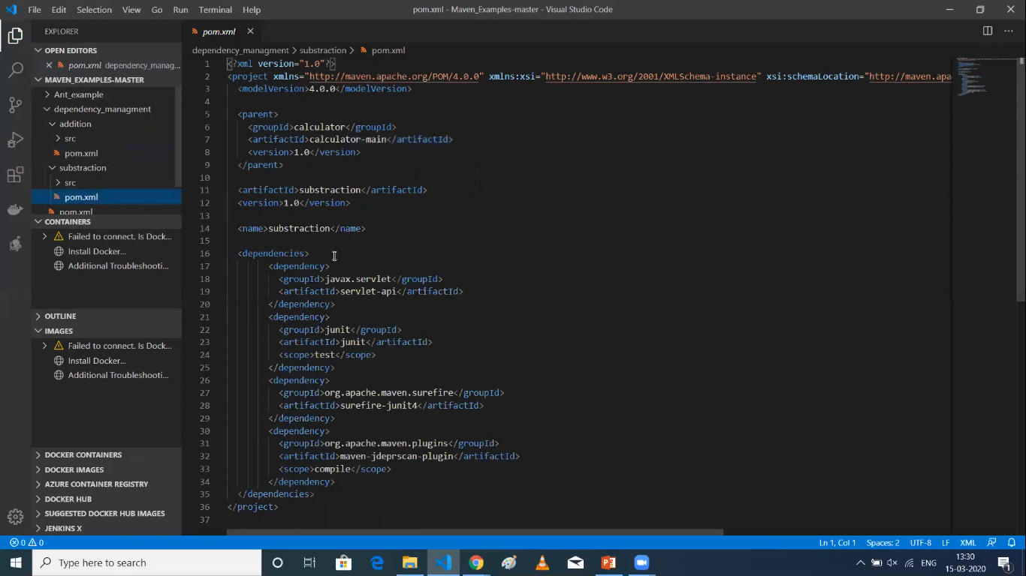

Slide 16
Rules for Multi-Module Project
1) In parent pom.xml the packaging should be in pom
<packaging>pom</packaging>
2) Under modules we need to mention what are sub-modules
<modules>
<module>addition</module>
<module>substraction</module>
</modules>
3) In child pom.xml we need to mention what is the parent of this sub-module
<parent>
<groupID>Calculator>/groupID>
<artifactID>calculator-main</artifactID>
<version>1.0</version>
</parent>

Slide 17
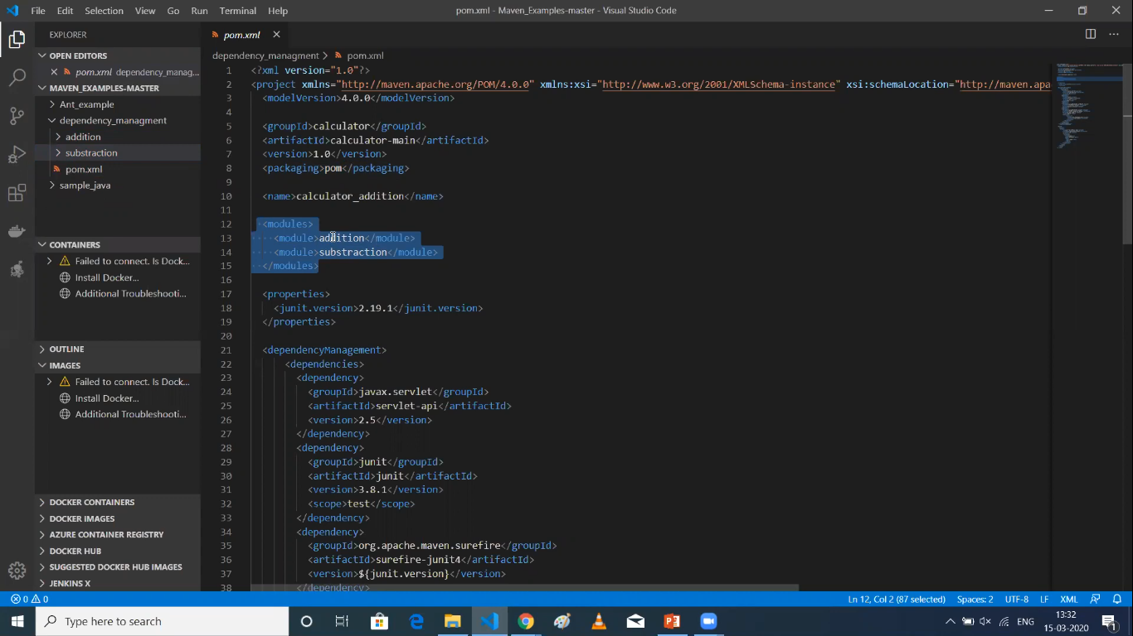

Slide 18
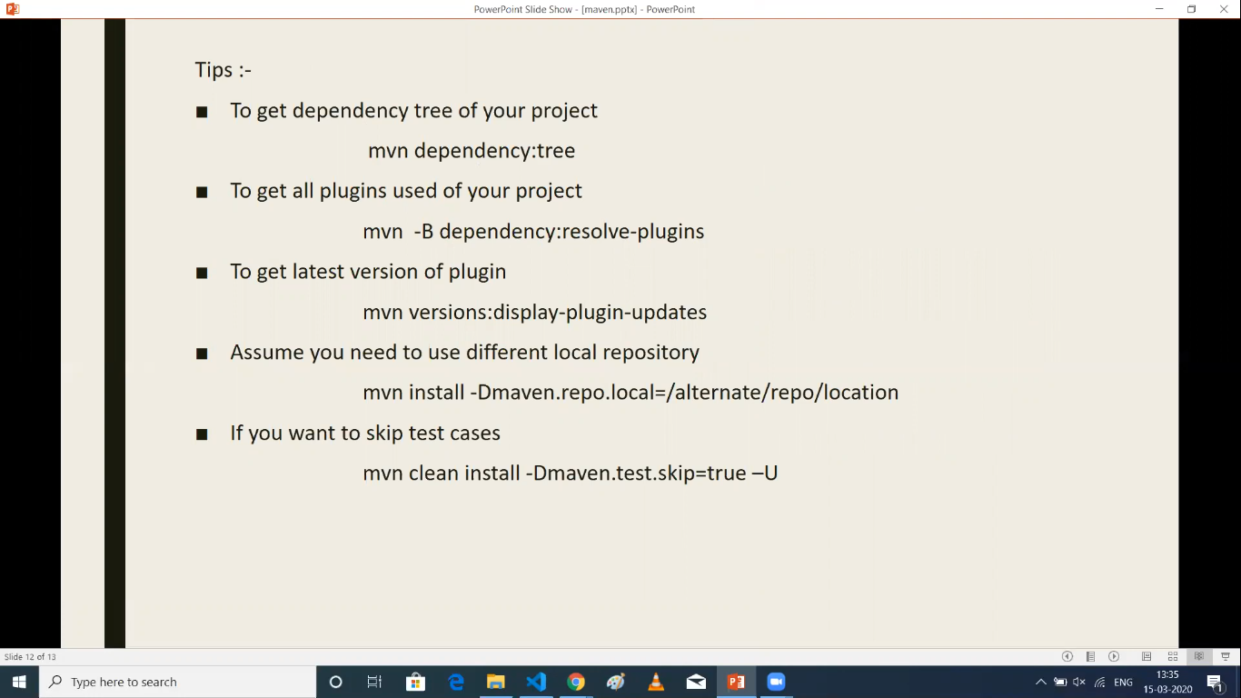
mvn dependency:resolve-plugins
Remove –U if doesn’t work

